Slide 1
Human Resource Dashboard

Slide 2
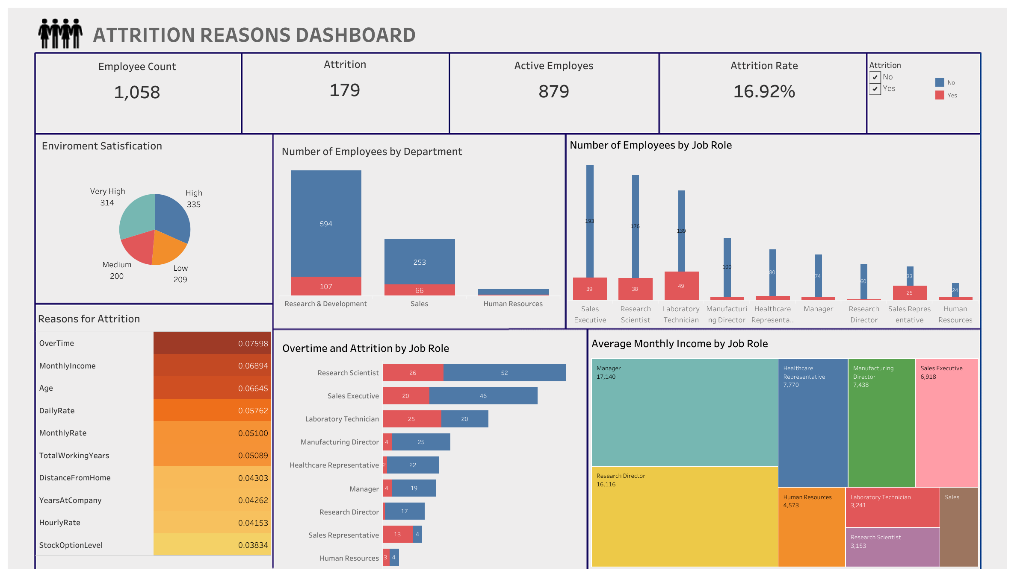

Slide 3
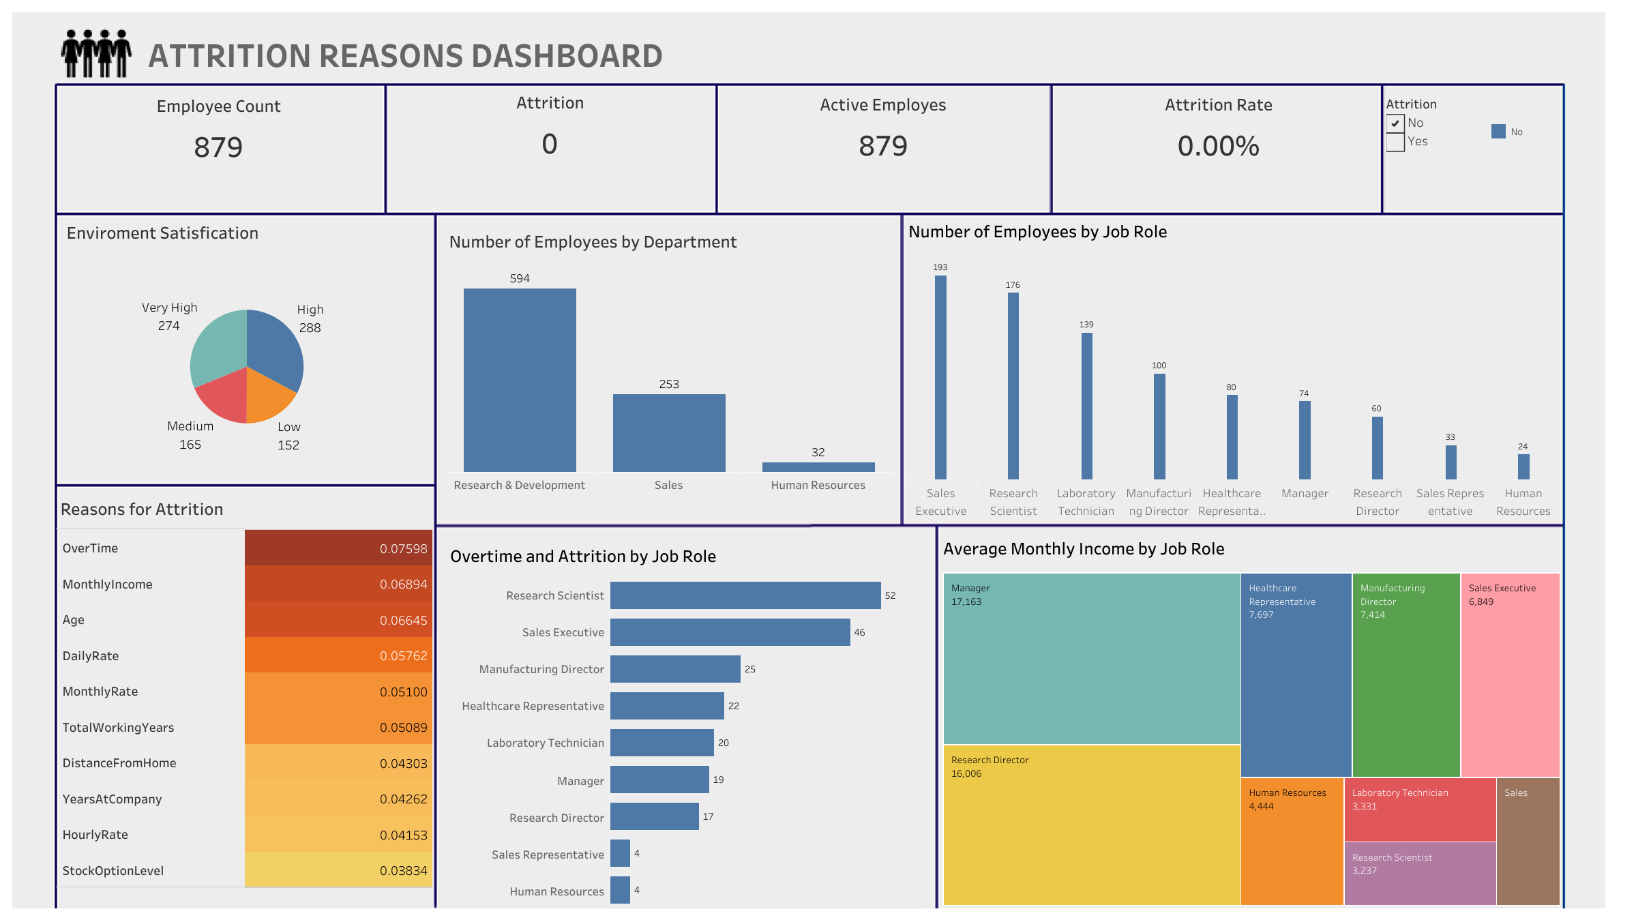

Slide 4
